Slide 1
Build Native Cross-Platform apps with .NET MAUI & Blazor Hybrid Workshop
Part 4 – Platform Features

Slide 2
Accessing Platform Features
Deep integration with the apps on a platform
No browser sandbox!
Still limited to the app sandbox
Including permissions
No performance loss or different behavior than .NET MAUI
Blazor is a .NET app talking to .NET APIs
Notes:
Blazor Hybrid apps have full access to the .NET MAUI abstractions and the native device features. This makes it easy to do native things that can be difficult or impossible on the web alone. You can do things like call native API's, access the file system, make phone calls, format the c: drive! OK please don’t do that, but you get my point!
Important to highlight here again, Blazor runs as a .NET app. No server or WebAssembly, it’s a .NET app already talking to .NET APIs to enable device functionalities. There is no difference in performance or behavior from using this with .NET MAUI directly.

Slide 3
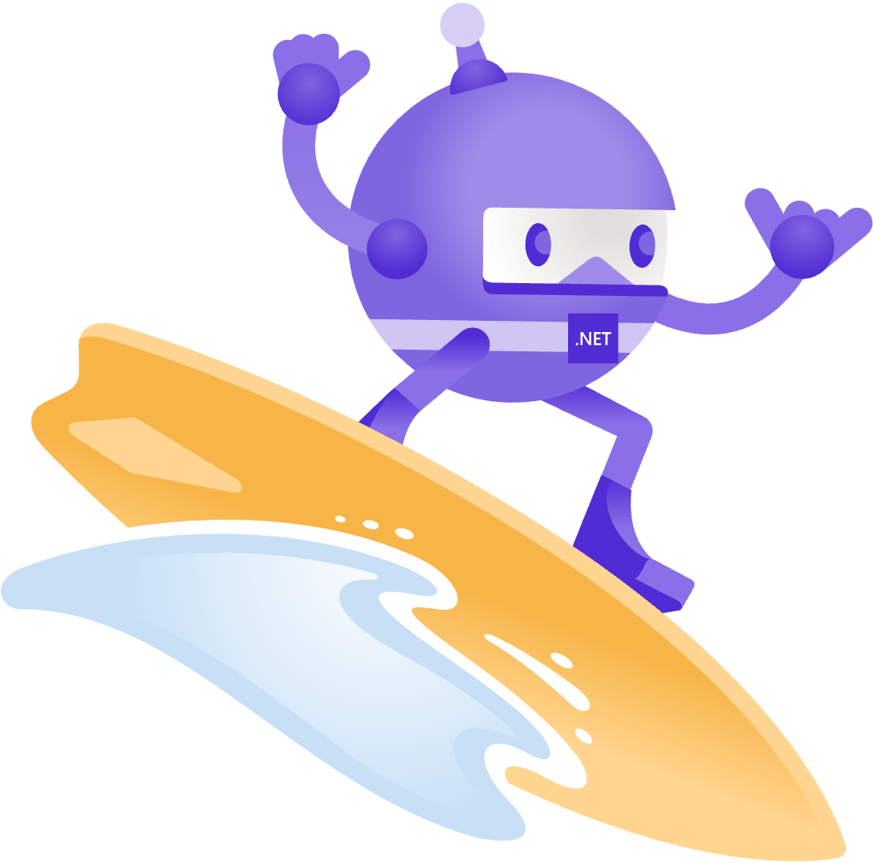
.NET MAUI Has Got You Covered!
Sms
Secure Settings
Preferences
Flashlight
Clipboard
Gyroscope
Magnetometer
Geolocation
Phone Dialer
Device Display Info
Email
Device Info
Battery
Compass
Accelerometer
Screen Lock
Data Transfer
Text to Speech
Geocoding
File System
Connectivity
Vibration
aka.ms/xamarinessentials
Notes:
MAUI offers a simple way to access native APIs from shared code. This integrates super easily with Blazor so you can leverage the platform features in your app.
Here is a sample of some of them.

Slide 4
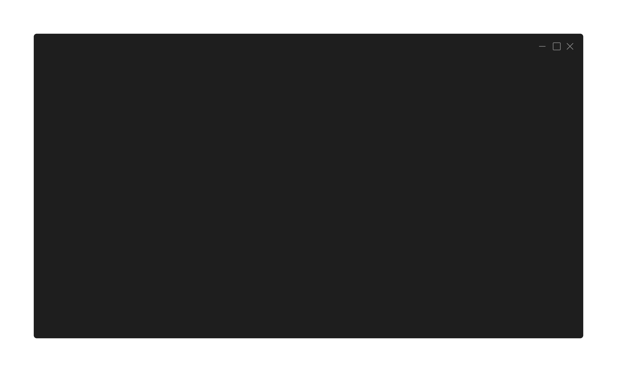
Static Usage
// OptionsPage.razor
var hasInternet =
Connectivity.Current.NetworkAccess == NetworkAccess.Internet;
var internetType =
Connectivity.Current.ConnectionProfiles.FirstOrDefault();
Notes:
There are two ways of consuming these APIs. You can use the static implementation and just call on that directly as shown here.

Slide 5
Dependency Injection
// MauiProgram.cs
public static MauiApp CreateMauiApp()
{
var builder = MauiApp.CreateBuilder();
// Some code omitted for brevity
builder.Services.AddSingleton<IGeolocation>(sp => Geolocation.Default);
// Some code omitted for brevity }
Notes:
Or you can also use these APIs trough dependency injection. First register the service in the MauiProgram.cs. By doing it like this it will use lazy loading so the concrete service is only instantiated when needed.

Slide 6
Dependency Injection
// Home.razor
@page "/"
@inject IGeolocation geolocation
@code {
private async Task FindMonkey()
{
await geolocation.GetLocationAsync();
}
}
Notes:
Then you can inject the depency where you want and make the calls on it. In this case to get the current location of the device.

Slide 7
Some Examples
Check connectivity for online/offline scenarios
Access device’s geolocation
Set “safe” layouts for different hardware notches, Dynamic Island, etc.
Notes:
Some examples of what you can do in your Blazor Hybrid app can be seen here. And these are exactly the scenarios that we will implement in our MonkeyFinderHybrid app!

Slide 8
Part 4 – Platform Features
https://aka.ms/blazor-hybrid-workshop

